Slide 1
Agenda 11/10
Project 4: Drawing Machines
Intro to Physical Computing

Slide 2
Project 4: Drawing Machines

Slide 3
Challenging the act/concept of drawing

Slide 4
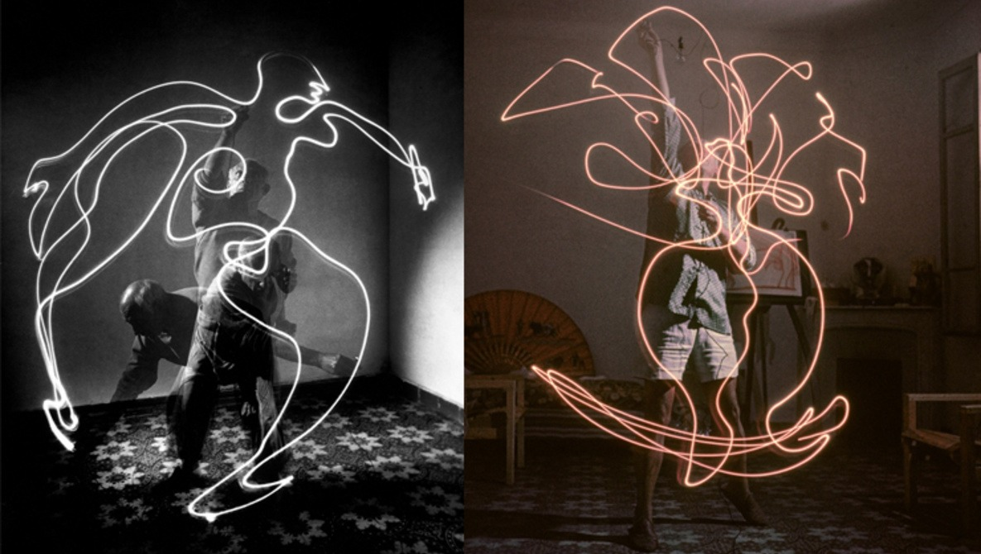
Picasso Light Paintings (1950s)

Slide 5
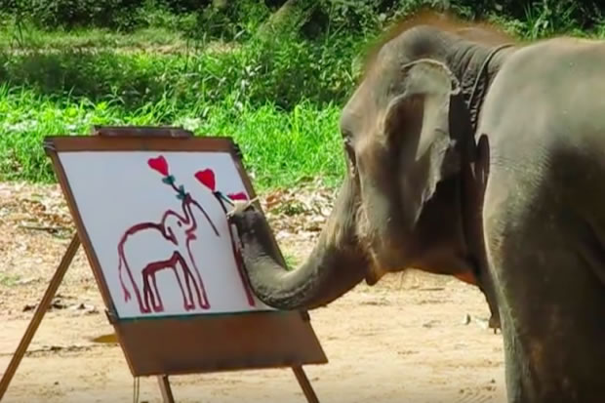
Suda the Painting Elephant
https://www.youtube.com/watch?v=foahTqz7On4

Slide 6
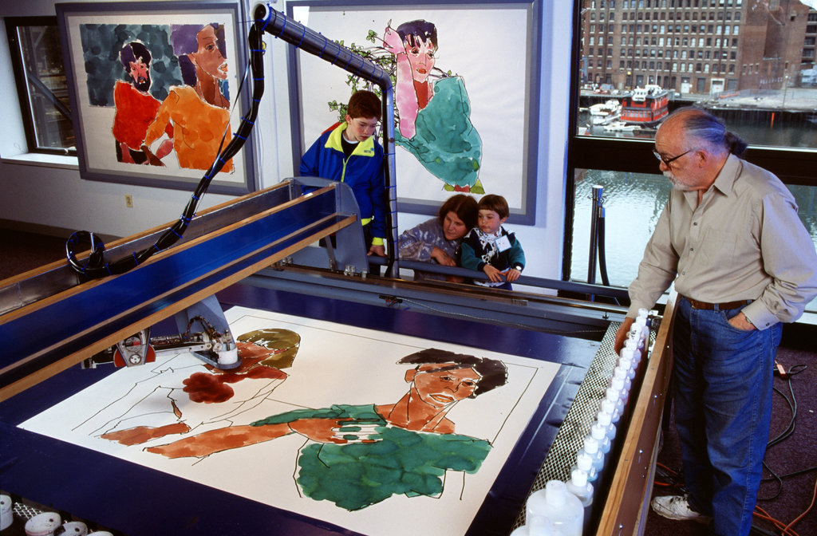
AARON by Harold Cohen
https://www.youtube.com/watch?v=foahTqz7On4

Slide 7
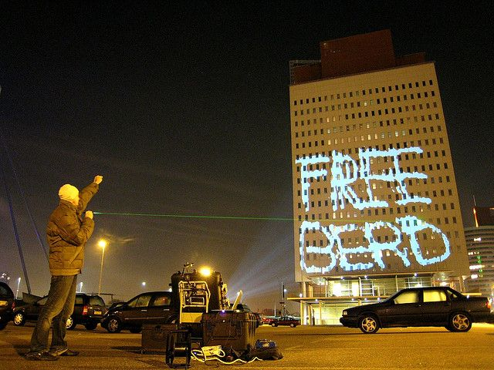
L.A.S.E.R. Tag by Graffiti Research Lab
https://www.youtube.com/watch?v=DKbtTPYZEig

Slide 8
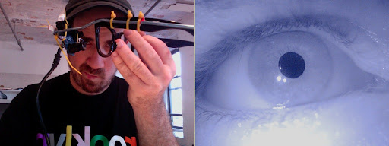
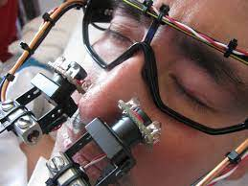
EyeWritter by Graffiti Research Lab
https://www.youtube.com/watch?v=84H-xLrLvvk

Slide 9
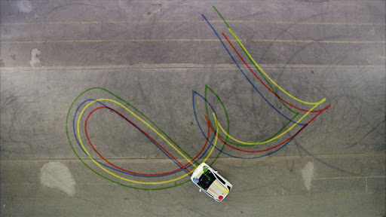
IQ Font (2010) by Zachary Lieberman
https://vimeo.com/5233789

Slide 10
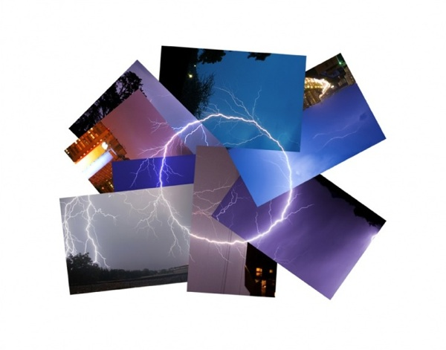
Lightning Series, by Cassandra C. Jones (2011):
https://www.cassandracjones.com/lightning-drawing-circles

Slide 11
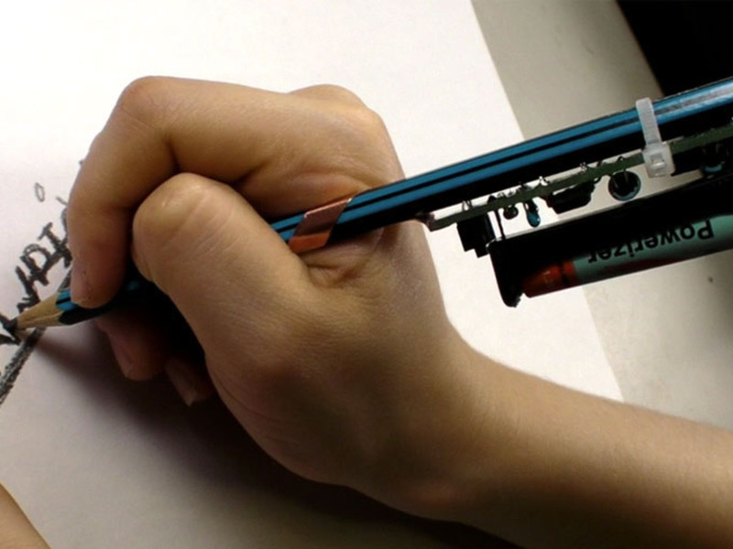
Drawdio (Jay Silver, 2008)
https://www.youtube.com/watch?v=PV_w38ldZaE

Slide 12
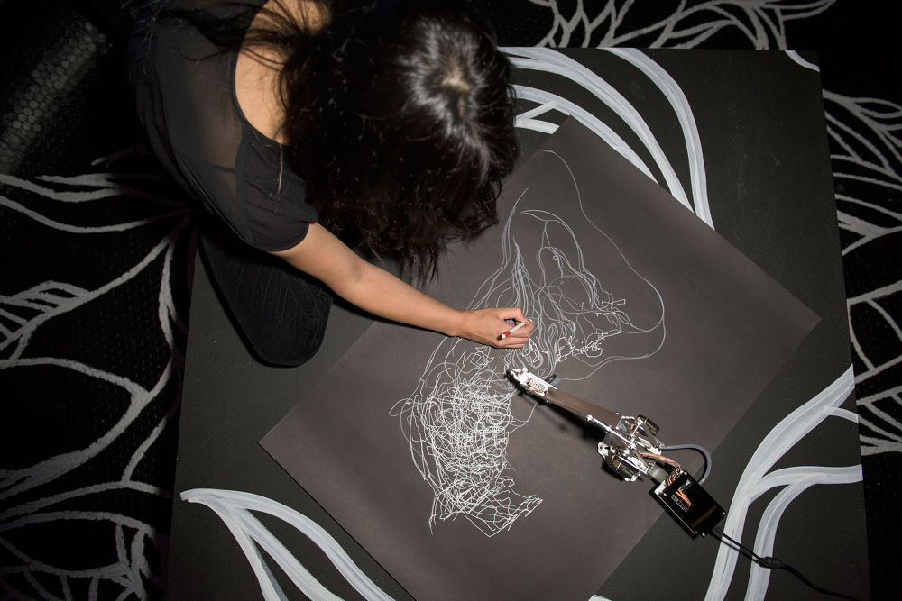
Drawing Operations by Sougwen Chung
https://sougwen.com/

Slide 13
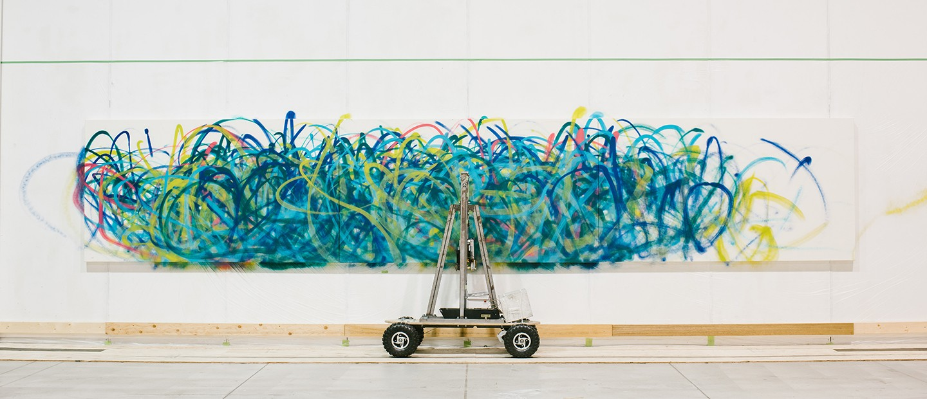
Senseless Drawing Bot (2012) by So Kanno & Takahiro Yamaguchi
https://vimeo.com/30780208

Slide 14
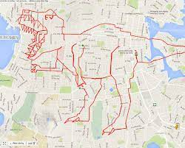
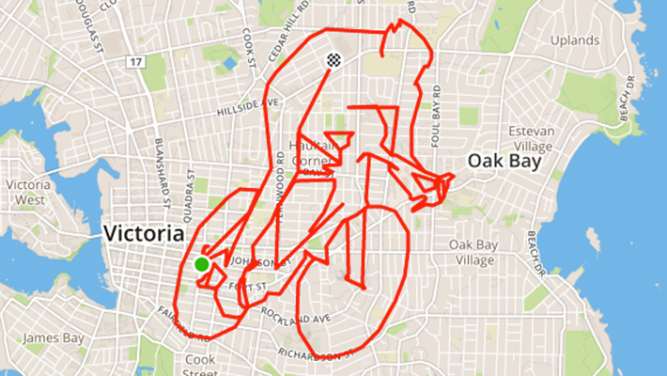
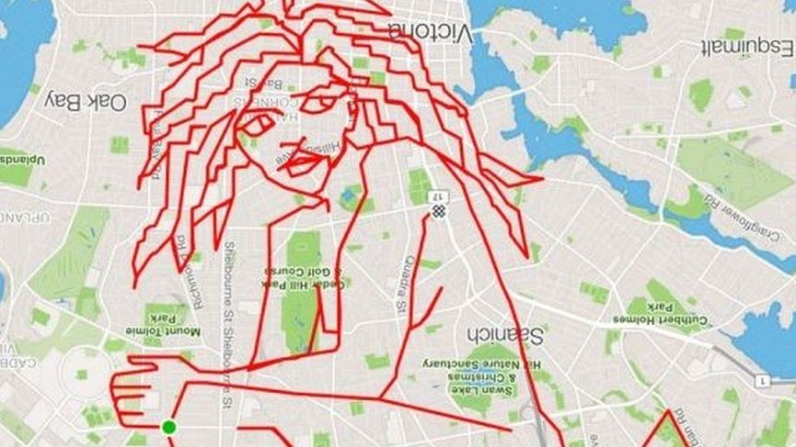
GPS Drawings
http://www.gpsdrawing.com/gallery.html

Slide 15
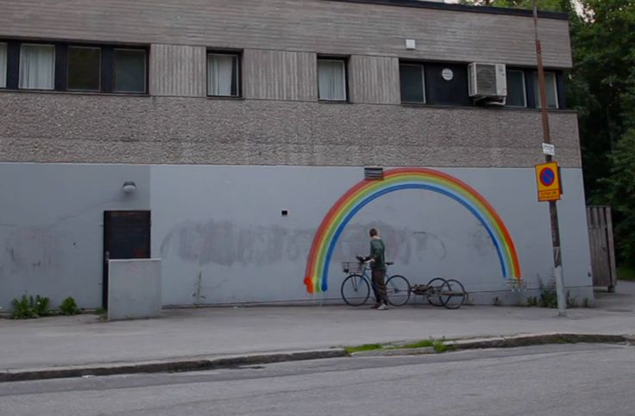
Graffiti Rainbow Bike (2012) by CROMATICS
https://vimeo.com/47245840

Slide 16
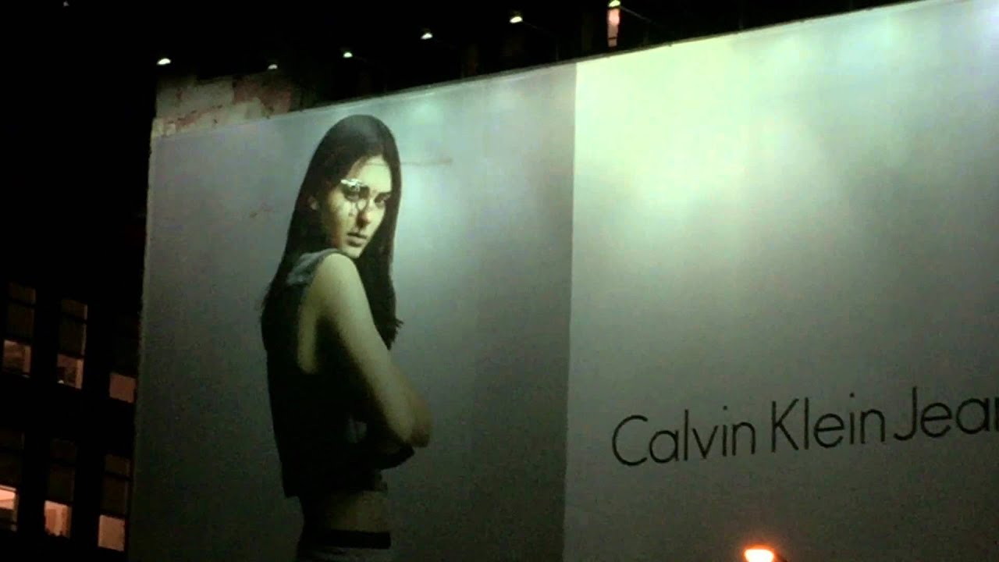
Drone Drawing on Kendall Jenner (2015) by KATSU
https://www.youtube.com/watch?v=We12p6yvNW0

Slide 17

Tree Drawings by Tim Knowles

Slide 18
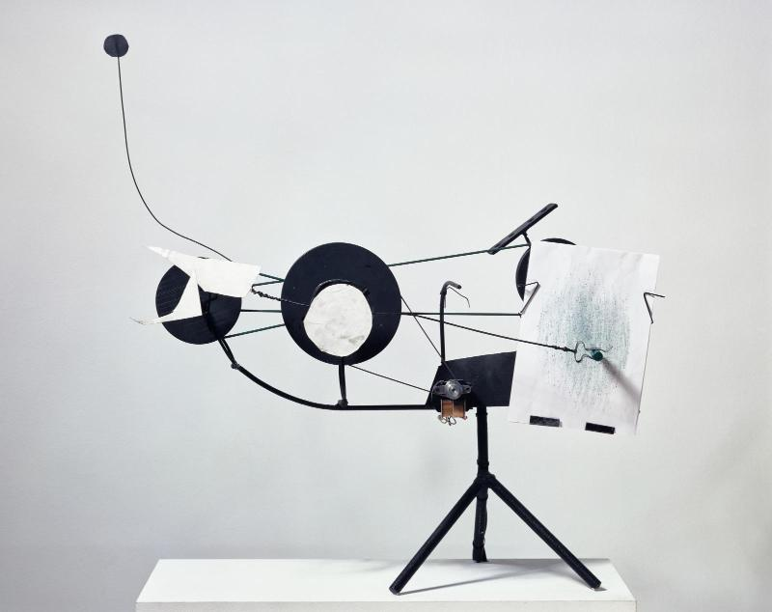
Metamatics by Jean Tinguely
https://www.youtube.com/watch?v=4-NrTsq6bsg

Slide 19
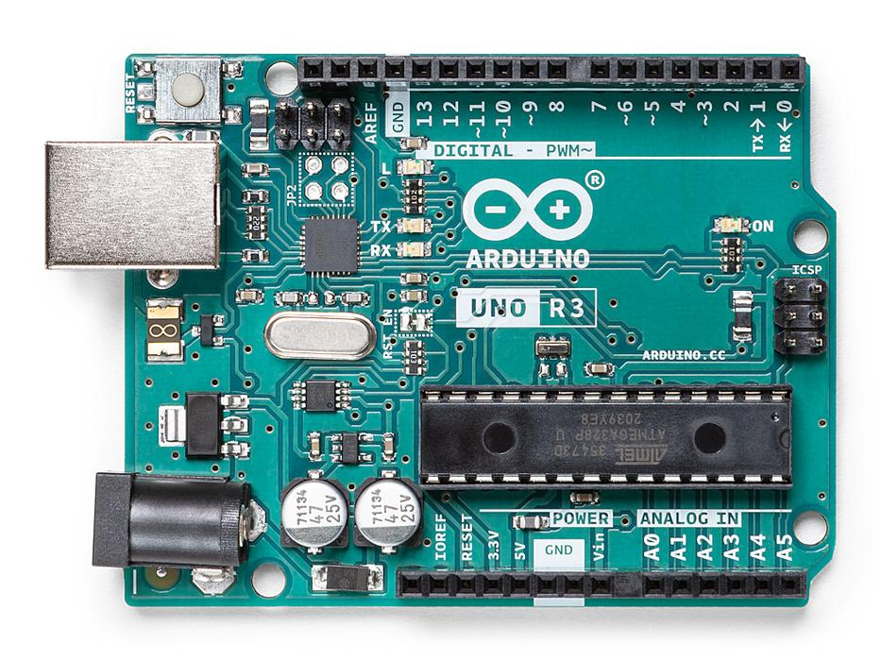
Physical Computing
Inputs
Outputs
Arduino (Microcontroller)

Slide 20
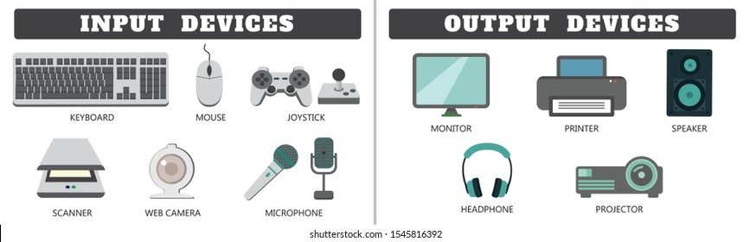
Physical Computing

Slide 21
Physical Computing
Inputs
(SENSORS)
Outputs
(ACTUATORS)
Arduino (Microcontroller)

Slide 22
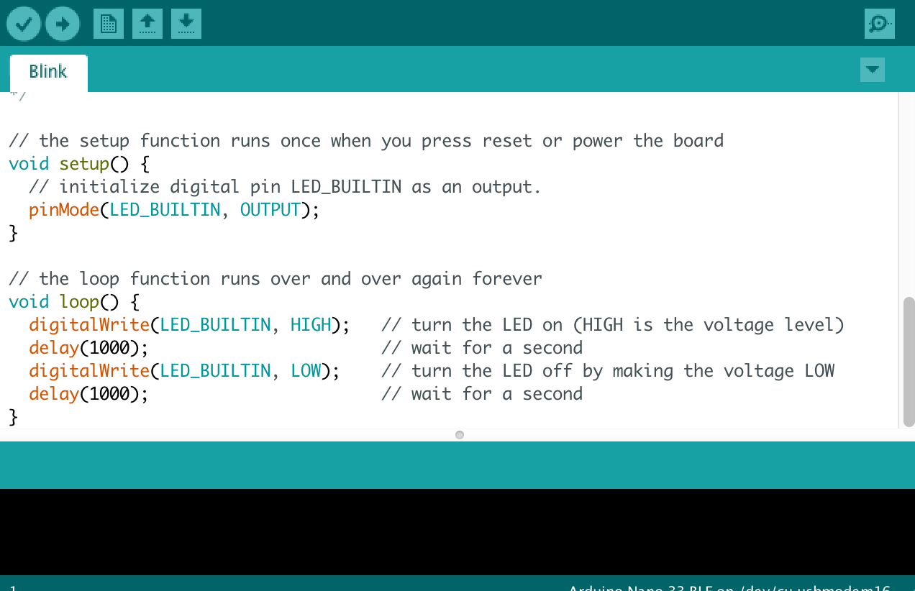
Arduino
Hardware
Software
Community
https://www.arduino.cc/

Slide 23
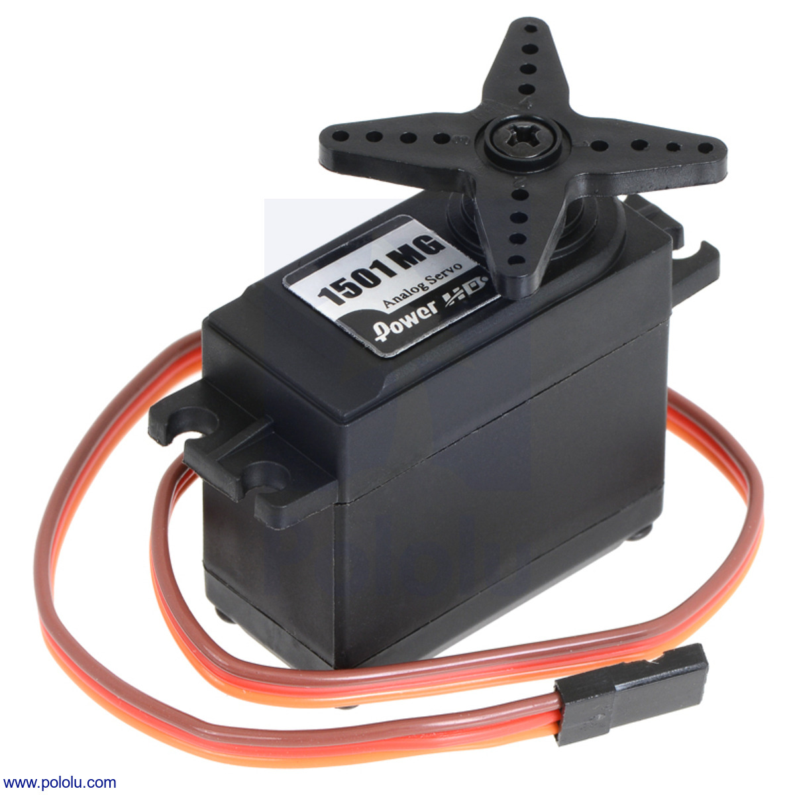
Servos (Actuator)
Servo: 180 or 360 type

Slide 24
Cost of parts for Project 4
Arduino - $15.00
180 Servo - $5.00
360 Servo - $7.50
Extra for physical parts and construction

